Slide 1
Voice of Citizen V-2.0
Under Guidance:
Mr.Sayeesh, Assistant prof
Cse dept , AIET Mijar.
Project Mates:
Imran Khan
Manish B Shriyan
Vignesh Shetty
Vighnesh Pejathaya

Slide 2
Introduction:
The proposed product provides the mobile application to raise complaint to the panchayath in which the citizen resides .
The main function of this system is to register complaint by taking the photo and uploading it with accurate location to the panchayath. It also provides complaint tracking facility.
The project includes three users: citizen, panchayath and administrator.
Citizen: The citizen is the one who raises complaint .
Panchayath: Panchayath are the authorities who solve the problem addressed by the citizen.
Administrator: Administrator are the people who add new panchayath to the system and have all the rights on the system.

Slide 3
Literature survey
Zhilong Yang et.al proposed Real-time Interactive Application Development Model on the Android Platform that uses persistent socket connection mechanism to establish the connection of clients and servers and protocol buffers as the transmission medium. In order to maintain the smooth connection with the server in the communication process, clients send keepalive packages to servers at regular time. In addition, this model adds retransmission mechanism and reconnection mechanism to ensure the correctness of the packages and the robustness of the system. This module has a good performance in network data consumption, power saving and the correctness of the packages etc. The real-time interactive android application is drawing more and more attention from users because of its real-time and interactivity. This kind of communication mechanism can avoid the errors caused by the delay of message. The real-time interactive application running in android platform should have the following characteristics
• power saving,
• less network data consumption,
• high speed to process the data from server and send data to server,
• the correctness of the packages.

Slide 4
Additional Requirements Provided:
In User Android Application:
Cancel Aadhar pic Upload Option.
Make Email optional.
Make User mobile/email as login Id.
Notification for Camera resolution to be more than 2MP while Capturing photo.
Send otp to mobile number in case of change in login credential.
Make photo visible or tick mark after uploading.
Add radio buttons for status of complaint, default pending, then either solved or rejected.
Write a note to upload genuine pic/complaint.

Slide 5
Write a note to upload genuine pic/complaint.
While user registers for complaint ask for phone number.
At splash page use a best tag line.
Description about the app.
Note: Use Gov India free Cloud Storage.

Slide 6
In Panchayath Application:
Remainder for not attending Complaint after 3 days.
Schedule for solving complaint should be removed.
After complaint is validated give buttons for only solved/rejected/default pending.
Phone number access for panchayath officer of the user who has registered the complaint.
Use pie chart instead of bar graph.
Make panchayath member login through ID’s provided to the respective Panchayaths.
Completed task should be removed from completed columns
Provision to upload Pictures after completing the work.
“The android application should be developed for Panchayath members”

Slide 7
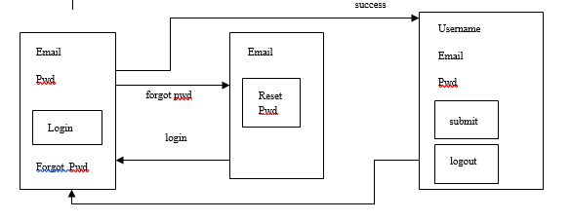
System Design:
Admin login:

Slide 8
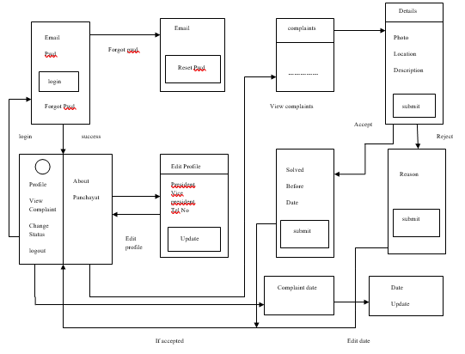
Panchayath login:

Slide 9
Thank you

